Slide 1
MOVIES DATASET CLASSIFICATION
Team Members:
Kanagala Aashitha -19BCD7159
U. Hrushikesh Chowdary – 19BCI7073
Tadisetty Sai Ravi Teja -19BCE7150
Nittoor Vishnu Bharadwaj – 19BCE7478
Guided By:
Prof. Gopi Krishnan S

Slide 2
OBJECTIVE:
The main objective of this project is to predict the movie genre that gives the most success rate and what movie genre they should choose.

Slide 3
MOTIVATION:
The main reason behind this project is that the directors or producers or anyone related to film industry can easily choose what type of genre attracts the audience the most. And due to this they can come up more with the genre with the most success rate.

Slide 4
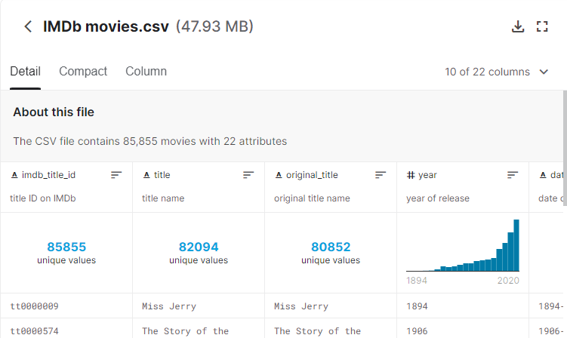
DATASET:
https://www.kaggle.com/stefanoleone992/imdb-extensive-dataset
The data preparation process begins with finding the right data. We downloaded the dataset from Kaggle after searching from different websites.

Slide 5
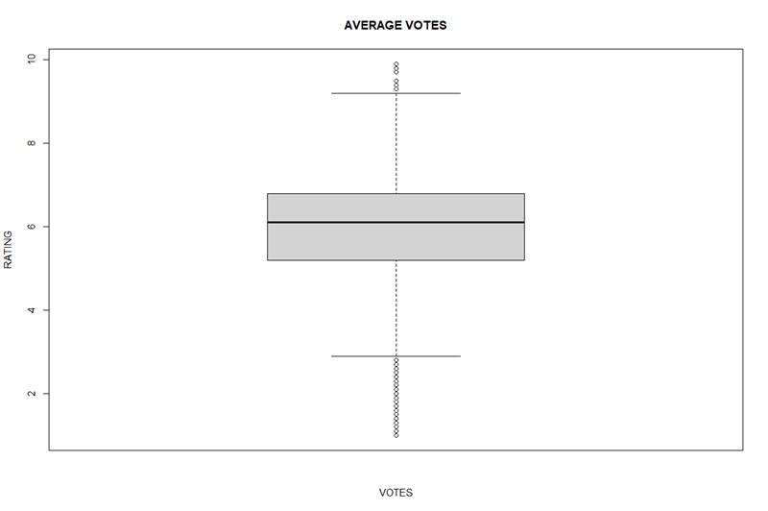
CLEANING:
Deleting the rows with NA values.
Detecting outliers using boxplot.

Slide 6
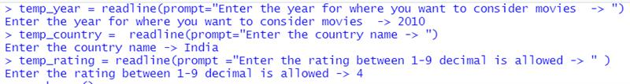
DATA PREPROCESSING
Converting the genre and country attributes from multivalued attribute to single valued attributes.
Subset of attributes are selected which are required for data analysis.

Slide 7
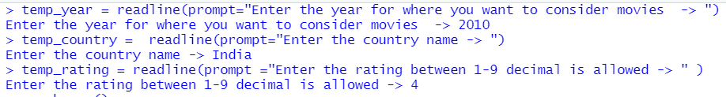
DATA ANALYSIS:
If the user selects-
year = 2010+
country = India
Rating = 4+

Slide 8
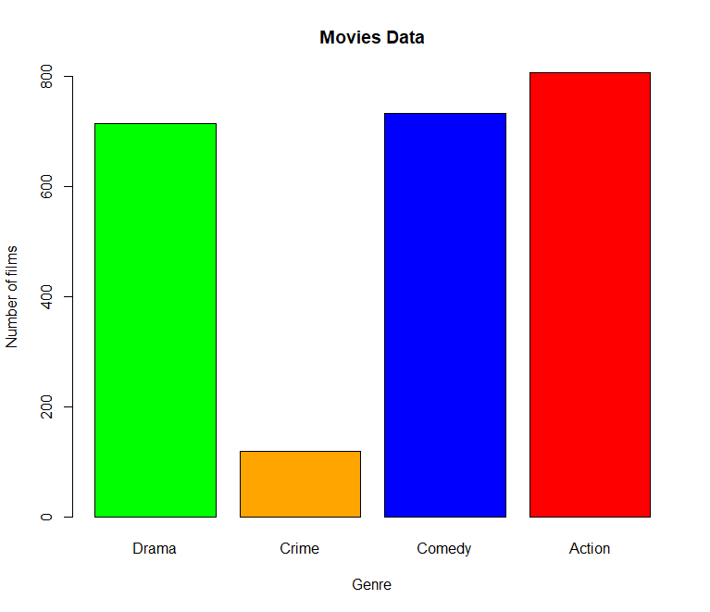
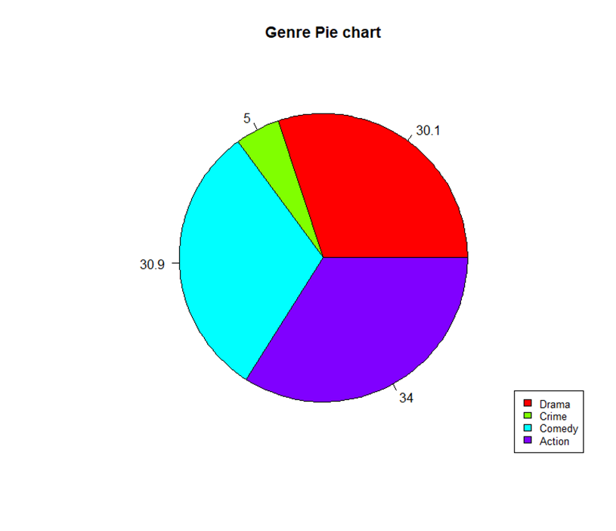
BARPLOT:
PIECHART:

Slide 9
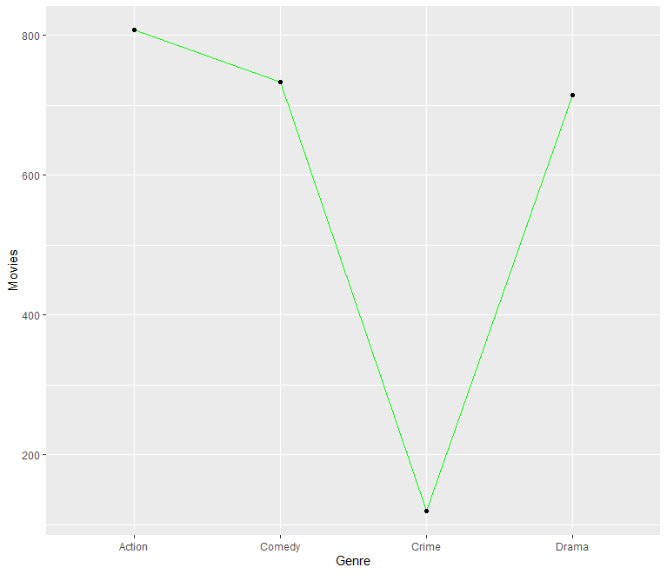
LINE CHART:

Slide 10
Conclusion:
We can now conclude this project with a specific case. Assume that if a user wants to make a movie he selects the country, year, and rating to analyze. Based on the graphs there is a high probability of making profits if the user makes an action film.
The probability order for our dataset goes as
Action-> Comedy->Drama->Crime.

